Slide 1
Breakdown Of Crime In Ireland - 2016
By Seán Keenan, Brian Kerwick and Dylan Teehan

Slide 2
Investigation
For our project we chose to investigate ‘The Breakdown of Crime in Ireland in 2016’.
Crime in Ireland is a very interesting topic and is always a hot topic in the news in our country.
In this project, we took a look at number of crimes, where it happened, types of crimes committed and the information on Gardaí and stations in each area.
We found our data on various websites (sources listed in final slide) and this helped us to complete this project.
We then obtained all data and implemented it into Google Sheets and Google Docs.
Once we had all of our data, we broke it down into what we needed, what we didn't need and what we could find useful along the way.
We used graphs to present the data we worked out and when we were finished processing all the data and information.
We created a Google Slides to present everything we learnt about ‘The Breakdown of Crime in Ireland in 2016’.

Slide 3
Hypothesis
Before we started on our project, we spoke as a group on what we thought the results of this project would be.
We came to the conclusion that Dublin and Limerick would have very high rates of crime and more than likely the highest in Ireland. We made this prediction as the county is so densely populated and there is a lack of development in some areas.
We also predicted that there would be an outsider, a smaller county that has a high rate of crime… possibly due to lack of Gardaí and stations, lack of development in the area etc…
We were very interested in the project and looked forward to seeing if our hypothesis was correct.

Slide 4
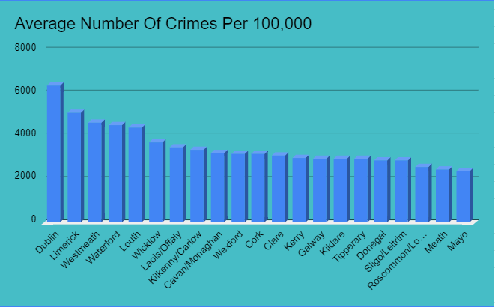
Avg Number of Crimes Per 100,000
Crime has been a huge problem in Ireland in recent years. This graph depicts the average number of crimes committed in each county per 100,000 people.
The graph clearly shows that Dublin is the most crime ridden county in Ireland for their population, followed by Limerick and Westmeath. While Mayo and Meath’s numbers are not as high. Wexford, Cork and Clare would be the median counties.

Slide 5
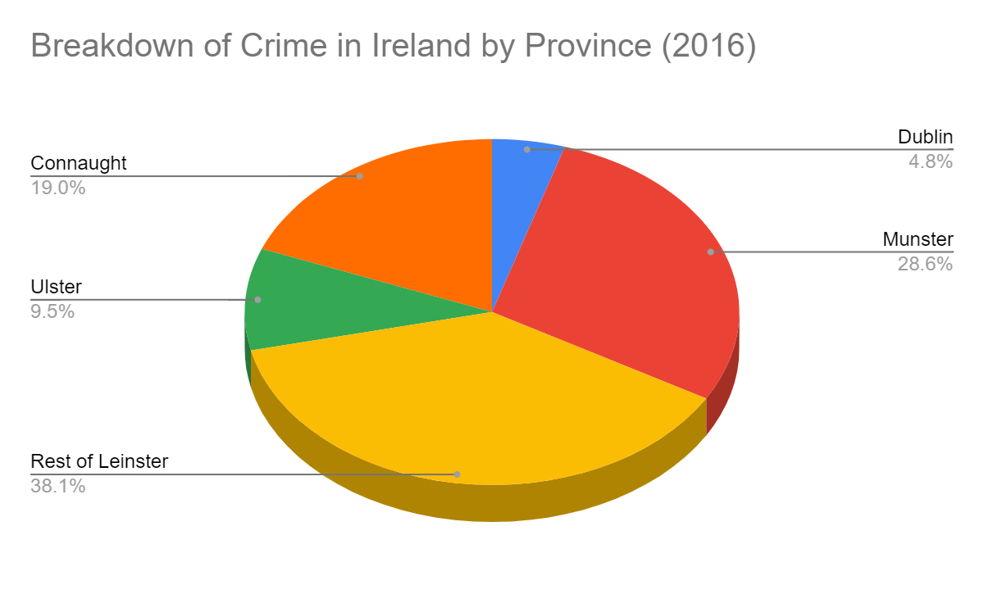
Breakdown of Crime by Province
We’ve looked at crimes committed per 100,000, but now we’re gonna look at the breakdown of crime by province.
The graph shows that Leinster (excluding Dublin) is the province with the most crime in Ireland, followed by Munster, then Connaught and finally Ulster.
Munster account for 28.6% of Irish crime with Limerick being the county with the highest crime rate in that region
Dublin still accounts for 4.8% of all crime in the country. This is a scarily high number for just a county itself and it shows there is massive problems with crime in the county.

Slide 6

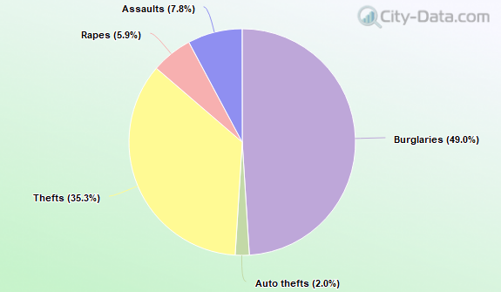
Types of crimes committed Dublin-2016

Slide 7
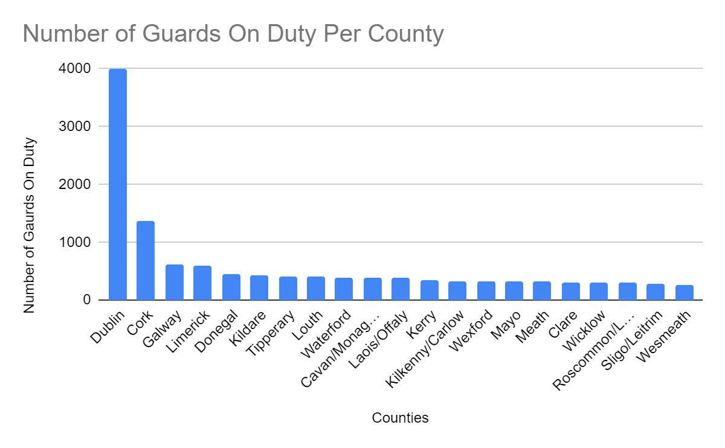
Distribution of Gardaí Throughout Ireland
As we can clearly see in this graph, Dublin outweighs all other counties with the number of guards on duty, we believe this is due to the large population and high amounts of crimes in this area as seen on previous graph. We see Westmeath has a low amount of guards on duty, which explains the high rates of crime in the overall area.

Slide 8

Mayo and Crime
Mayo has one of the lowest rates in Ireland and is rarely hit with crime or tragedy through crime. The crime rate is so low that they have started redirecting local Gardaí to other stations in different counties, and have even closed down a station in the county. This is all due to the low crime rates. The big question is, will the crime rate rise with the smaller number of Gardaí in the area? This is one thing the county will have to watch out for.
Here we see 2 articles that show the situation with Gardaí in Co.Mayo:
https://www.advertiser.ie/mayo/article/47538/mayo-garda-stations-to-close-in-cost-saving-measure
https://westernpeople.ie/2021/12/09/garda-numbers-in-mayo-have-declined-in-the-last-two-years/

Slide 9
Conclusion
After investigating and processing our data we found out a lot of things:
Dublin, Limerick and Westmeath has the highest crime rates in Ireland per 100,000 people.
Leinster (excluding Dublin) is the province with the most crime in Ireland, followed by Munster, then Connaught and finally Ulster.
Dublin significantly dominates all other counties with the number of guards on duty, while Westmeath is the county with the least amount of guards in Ireland.
Mayo’s situation with Gardaí, the reasons for this and the possible consequences that could come with it.
Looking back on our hypothesis, we were correct in saying that Dublin and Limerick would have very high rates of crime and more than likely the highest in Ireland. We also predicted that there would be an outsider, a smaller county that has a high rate of crime… this was proven correct, with Westmeath.
We all enjoyed finding out about the crime in our country, learning how to find and process data and all the work with numbers while processing this data.

Slide 10
Sources
https://www.kaggle.com/
https://www.cso.ie/en/index.html
https://www.advertiser.ie/mayo/article/47538/mayo-garda-stations-to-close-in-cost-saving-measure
https://westernpeople.ie/2021/12/09/garda-numbers-in-mayo-have-declined-in-the-last-two-years/
https://www.garda.ie/en/about-us/organisational-structure
https://www.cso.ie/en/census/census2016reports/

